Slide 1


Analysis of Airbnb Data Using Power BI
Notes:
Good afternoon, Sir. Today, I am here to present my Power BI project titled "Analysis of Airbnb Data Using Power BI" along with its PowerPoint presentation.

Slide 2
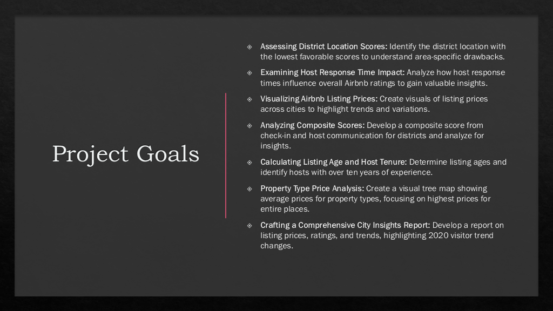
Notes:
The goals of this project are as follows
Assessing District Location Scores: in which we Identify districts with the lowest scores to understand specific area drawbacks.
Examining Host Response Time Impact: in which we Analyze how host response times affect overall Airbnb ratings for valuable insights.
Visualizing Airbnb Listing Prices: in which we Create visuals of listing prices across cities to highlight trends and variations.
Analyzing Composite Scores: in which we Develop and analyze a composite score from check-in and host communication for districts.
Calculating Listing Age and Host Tenure: in which we Determine listing ages and identify hosts with over ten years of experience.
Property Type Price Analysis: in which we Create a tree map showing average prices for property types, focusing on highest prices for entire places.
Crafting a Comprehensive City Insights Report: in which we Develop a report on listing prices, ratings, and trends, highlighting changes in visitor trends in 2020.

Slide 3
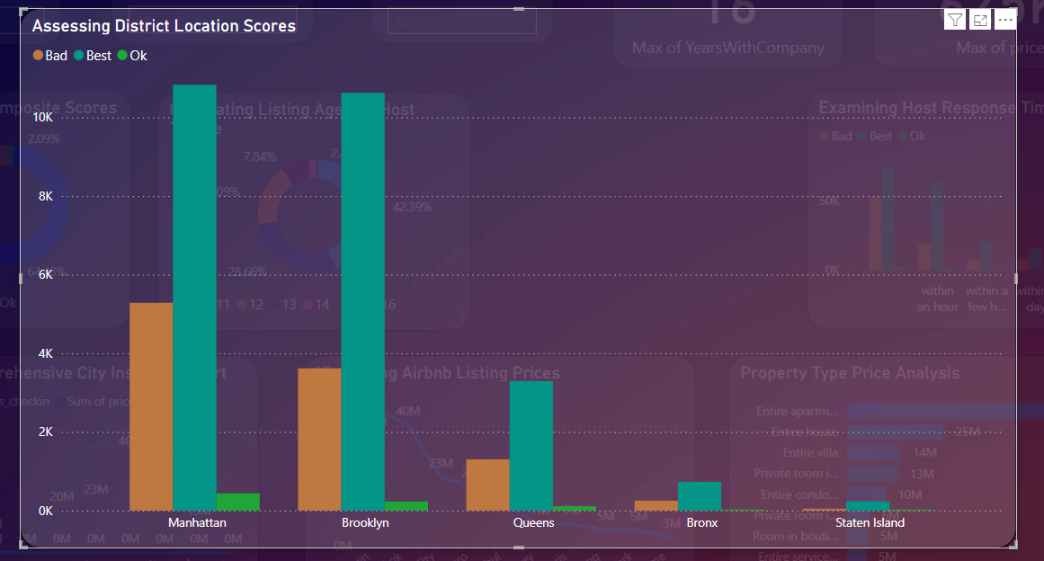
Assessing District Location Scores
Sugestion to remove bad sentiment
Detailed Descriptions: Provide comprehensive and honest descriptions of the properties and the surrounding area. Highlight both positive and negative aspects to manage expectations.
Clear Maps and Directions: Ensure that guests have access to clear and accurate maps and directions to the property. Include details about public transportation and nearby amenities.
Neighborhood Guides: Create guides that include information about local attractions, dining options, safety, and cultural tips.
Safety Information: Provide detailed information about the safety of the neighborhood, including tips for staying safe and emergency contact information.
Security Features: Highlight any security features available in the property, such as secure locks, alarm systems, and well-lit entrances.
The aim is to pinpoint the location in the district with the least favorable location scores. Solution - Staten Island
Notes:
This slide presents the first goal of the project which is “Assessing District Location Scores”
Suggestion to remove bad sentiment
For property descriptions, provide comprehensive and honest details about the property and surrounding area, highlighting both positive and negative aspects. Ensure guests have clear and accurate maps and directions, including information on public transportation and nearby amenities. Create neighborhood guides covering local attractions, dining options, safety, and cultural tips. Offer detailed safety information about the neighborhood, including staying safe tips and emergency contact information. Highlight security features such as secure locks, alarm systems, and well-lit entrances. The main aim is to pinpoint the location in the district with the least favorable location scores. Solution - Staten Island

Slide 4
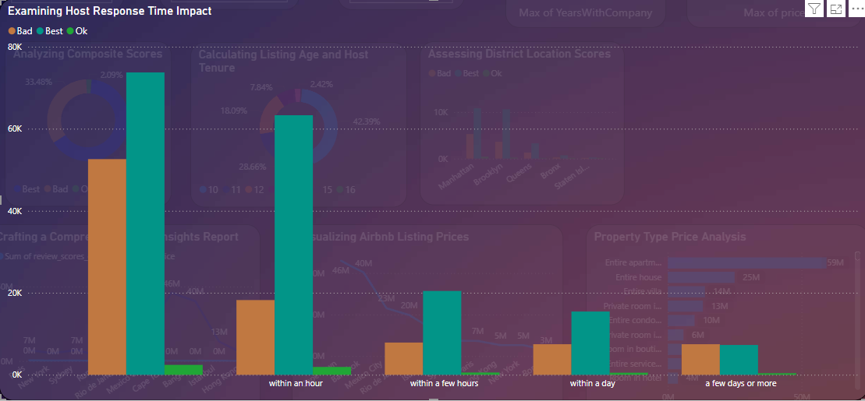
Examining Host Response Time Impact
Suggestion to reduce the bad sentiment
Accurate Response Time: Clearly state the typical response time in the listing description to manage guest expectations.
Automated Messages: Use automated messages to acknowledge guest inquiries immediately, even if a personal response will follow later.
Mobile Notifications: Enable mobile notifications to ensure hosts are alerted to new messages promptly.
Response Templates: Create response templates for common questions to speed up the communication process.
Notes:
This slide represents the second goal of the project which is “Examining Host Response Time Impact”
Suggestion to reduce the bad sentiment
To manage guest expectations, clearly state the typical response time in listings. Use automated messages to acknowledge inquiries immediately, even if a personal response will come later. Enable mobile notifications to ensure hosts are promptly alerted to new messages. Create response templates for common questions to expedite communication.

Slide 5
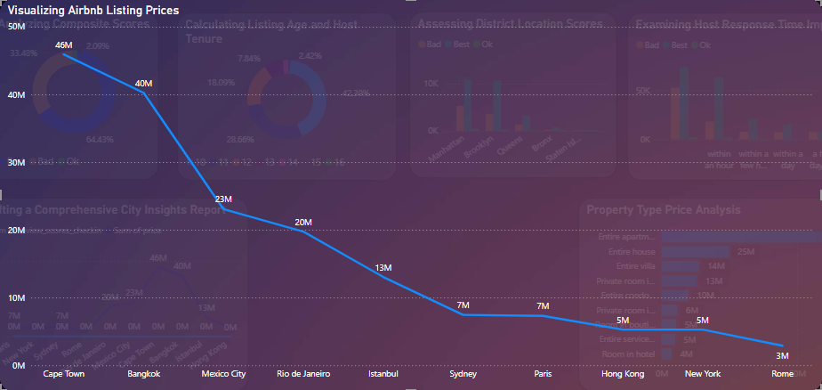
Visualizing Airbnb Listing Prices
Summary of the graph
The graph visualizes Airbnb listing prices across various cities, showing a descending trend in total prices:
- *Cape Town*: 50 million
- *Bangkok*: 46 million
- *Mexico City*: 40 million
- *Rio de Janeiro*: 23 million
- *Istanbul*: 20 million
- *Sydney*: 13 million
- *Paris*: 7 million
- *Hong Kong*: 7 million
- *New York*: 5 million
- *Rome*: 3 million
Overall, there is a sharp decline from Cape Town to Rome.
Notes:
This slide represents the third goal of the project which is “Visualizing Airbnb Listing Prices”
The chart visualizes Airbnb listing prices across various cities, showing a declining trend from Cape Town which is 50M to Rome which is 3M,

Slide 6
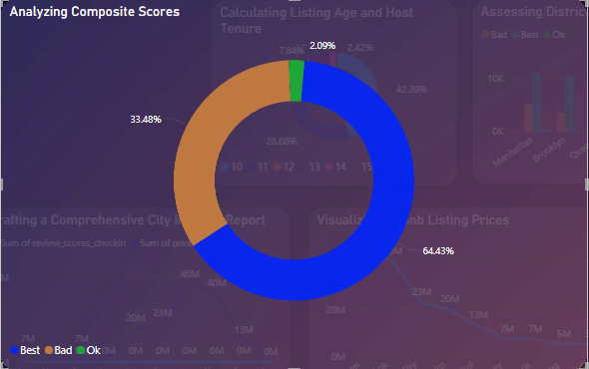
Analyzing Composite Scores
Suggestion to Decrease the bad sentiment
Clear Instructions: Ensure guests receive detailed, step-by-step instructions for the check-in process.
Flexible Check-In Options: Offer flexible check-in times and methods (e.g., self-check-in, lockboxes).
Welcome Kits: Provide a welcome kit with essentials and local information to make guests feel comfortable upon arrival.
Timely Responses: Ensure hosts respond promptly to guest inquiries and issues.
Proactive Communication: Encourage hosts to reach out to guests before their stay to confirm details and offer assistance
Notes:
This slide represents the fourth goal of the project which is “Analyzing Composite Scores”
Suggestions to decrease the bad sentiment Provide guests with clear, step-by-step check-in instructions and offer flexible check-in options such as self-check-in or lockboxes. Supply a welcome kit with essentials and local information to help guests feel comfortable upon arrival. Ensure hosts respond promptly to inquiries and issues. Encourage hosts to proactively reach out to guests before their stay to confirm details and offer assistance.

Slide 7
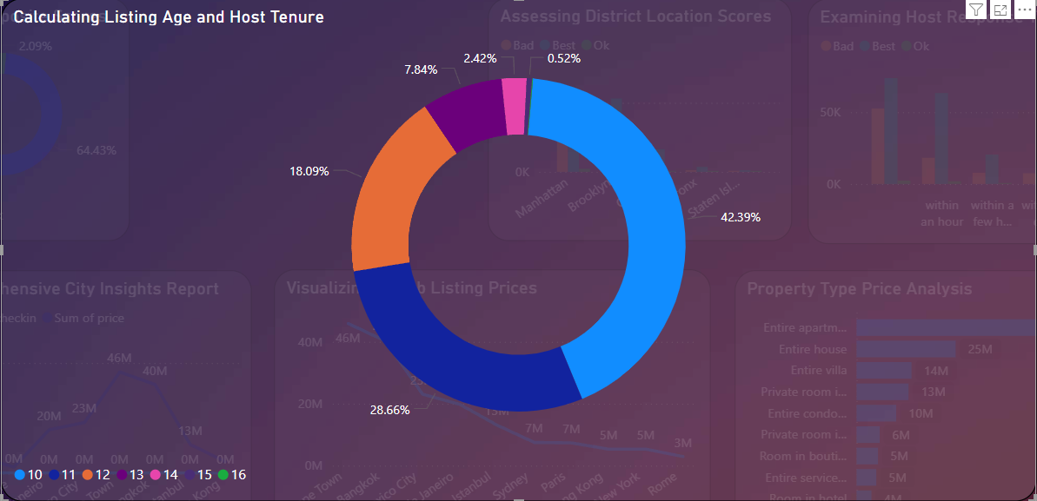
Calculating Listing Age and Host Tenure
The image is a donut chart titled "Calculating Listing Age and Host Tenure." The chart displays percentages representing different years of host tenure, each identified by a unique color. Here are the key details from the chart:
The largest segment (42.39%) is represented in light blue which shows the number of hosts which than 10 years of experience.
The next segment (28.66%) is represented in dark blue which shows the number of hosts which have 11 years of experience.
The next segment 18.09% is represented in orange which shows the number of hosts which have 12 years of experience.
The next segment 7.84% is represented in purple which shows the number of hosts which have 13 years of experience.
The next segment 2.42% is represented in pink which shows the number of hosts which have 14 years of experience.
The next segment 0.52% is represented in magenta which shows the number of hosts which have 15 years of experience.
The last segment 0.07% is represented in green which shows the number of hosts which have 16 years of experience.
Notes:
This slide represents the fifth goal of the project which is “Calculating Listing Age and Host Tenure” The image describes a donut chart titled "Calculating Listing Age and Host Tenure." It details the percentages of hosts based on their years of experience. Here is the summarized information:
42.39% of hosts have than 10 years of experience (light blue).
28.66% of hosts have 11 years of experience (dark blue).
18.09% of hosts have 12 years of experience (orange).
7.84% of hosts have 13 years of experience (purple).
2.42% of hosts have 14 years of experience (pink).
0.52% of hosts have 15 years of experience (magenta).
0.07% of hosts have 16 years of experience (green).

Slide 8
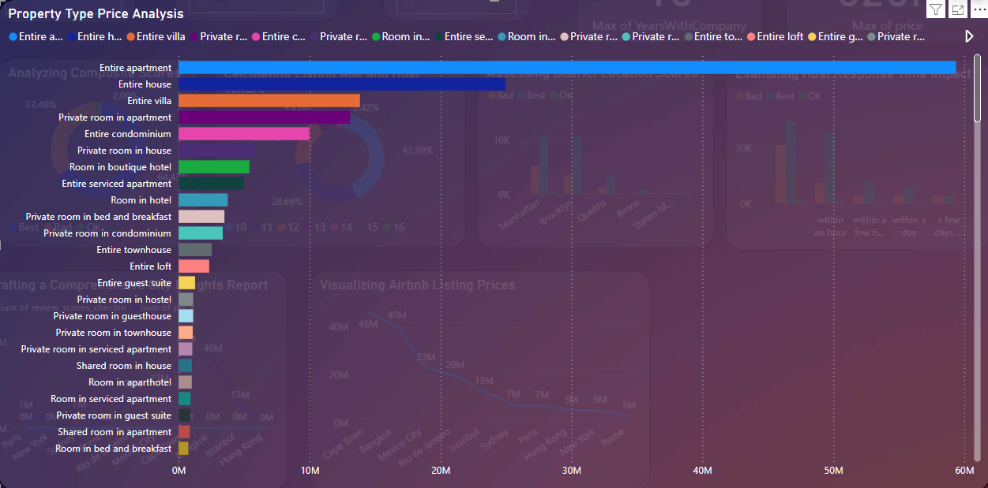
Property Type Price Analysis
The image shows a bar chart titled "Property Type Price Analysis," which compares the prices of different types of properties. The data indicates the following insights:
Entire Apartment is the most expensive property type by a significant margin.
Entire House and Entire Villa are the next most expensive property types, but they are considerably less expensive than Entire Apartments.
Private Rooms in Apartments, Entire Condominiums and Private Rooms in Houses follow, with moderate pricing.
Rooms in Boutique Hotels and Entire Serviced Apartments are also in the mid-range price category.
Rooms in Hotels and Private Rooms in Bed and Breakfasts have lower prices.
The chart highlights a wide range of property types and their associated price points, with Entire Apartments being the most expensive and various types of shared and private rooms being the least expensive.
Notes:
This slide represents the sixth goal of the project which is “Property Type Price Analysis”
The "Property Type Price Analysis" bar chart compares prices across various property types. Entire Apartments are the most expensive, followed by Entire Houses and Entire Villas, which are significantly cheaper. Moderately priced options include Private Rooms in Apartments, Entire Condominiums, and Private Rooms in Houses. Mid-range prices are seen for Rooms in Boutique Hotels and Entire Serviced Apartments. The least expensive are Rooms in Hotels and Private Rooms in Bed and Breakfasts. The chart illustrates the wide range of property types and prices, with Entire Apartments at the high end and shared or private rooms at the low end.

Slide 9
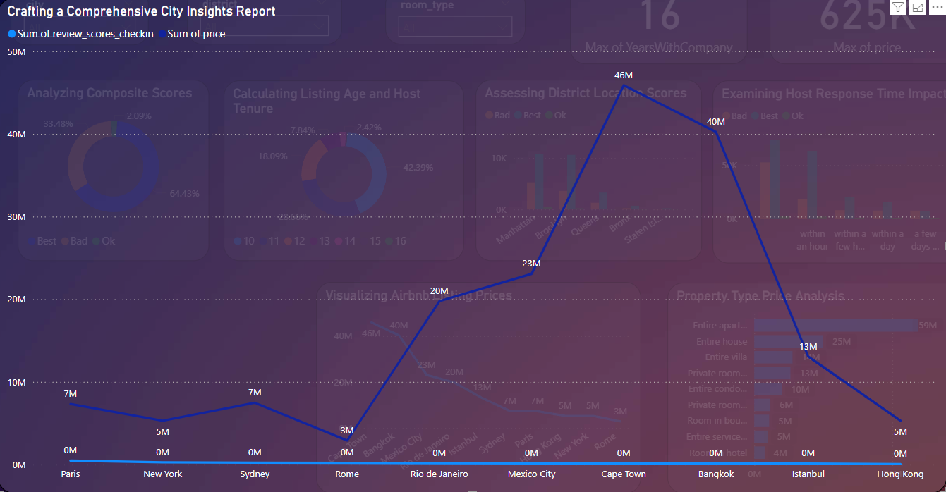
Comprehensive City Insights Report
Notes:
This slide represents the sixth goal of the project which is “Assessing District Location Scores”
The chart illustrates the sum of review scores for check-in and listing prices across various cities. Bangkok has the highest price at 46M, followed by Cape Town at 40M and Mexico City at 23M. Rio de Janeiro, Istanbul, and Paris also show significant prices of 20M, 13M, and 7M respectively. Other cities like New York, Sydney, Rome, and Hong Kong have lower prices, ranging from 5M to 0M. The review scores are indicated alongside the prices, suggesting a correlation between high review scores and higher prices in these cities.

Slide 10
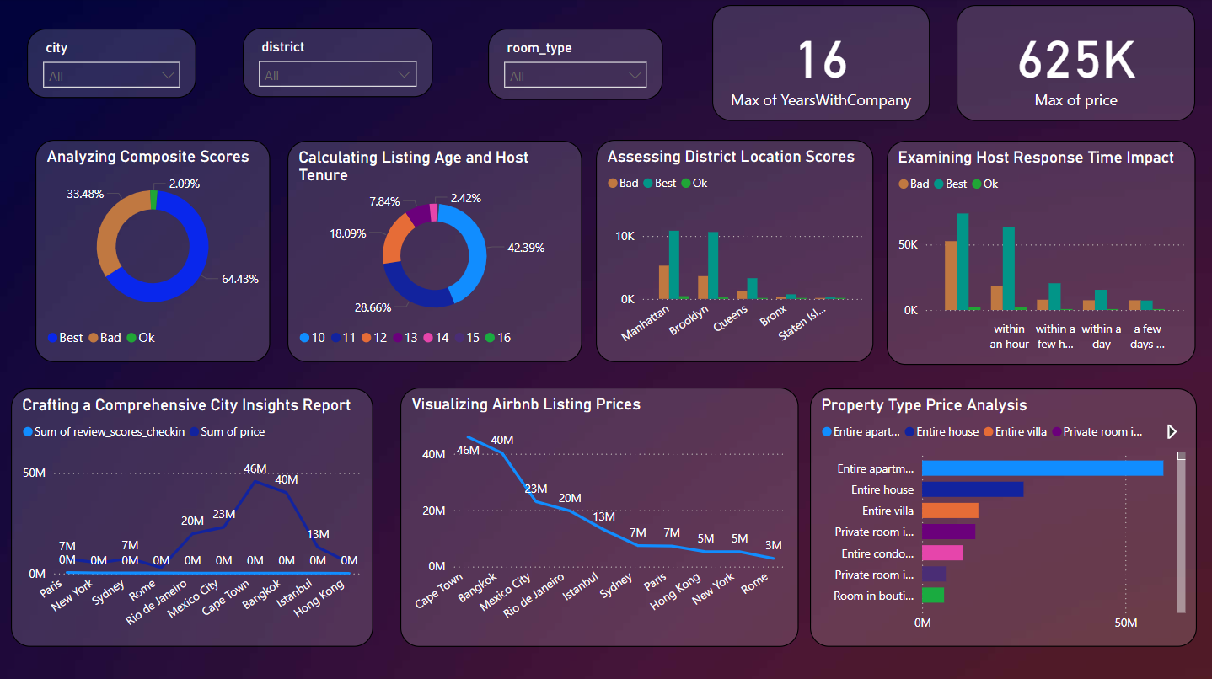
Final Report
Notes:
This slide represents the final report of the project

Slide 11
Thank you

